Slide 1
Colligative Properties: Vapor and Osmotic Pressures
Section 6

Slide 2
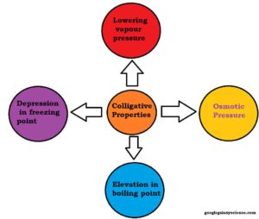

Slide 3
VAPOR PRESSURE
Molecules of a liquid will escape and exist as gases above the liquid
Eventually enough vapor escapes and an equilibrium results
The pressure of the gas molecules above the liquid is called its vapor pressure

Slide 4
The Formula
P = XP°
P is the vapor pressure of a solution
X is the mole fraction (moles of SOLVENT over total moles)
P° is the normal vapor pressure of the pure solvent (before the solute was added)

Slide 5
Osmotic Pressure
This is the pressure that is needed to stop osmosis
Osmosis is the process of solvent molecules passing through a semipermeable membrane from a less concentrated solution into a more concentrated one

Slide 6
The Formula
π = MRT
π is osmotic pressure
M is molarity (mol/L)
R is the ideal gas constant (0.08206)
T is temperature in Kelvin

Slide 7
Example Problems
Calculate the vapor pressure of a solution containing 22.5 g of lactose (C₁₂H₂₂O₁₁) and 200.0 g of water. Assume that the vapor pressure of pure water is 149 torr.
Calculate the osmotic pressure of a solution containing 22.5 g of NaCl and 0.500 mol of water at 299 K.

